Slide 1
Solid State Computing
Dr. Charles R. Severance
www.ca4e.com
online.dr-chuck.com

Slide 2
Outline
The transistor
Faster than a relay or tube
Far less heat and electricity
Far more reliable and long lasting
No moving parts
Replaced tubes for amplifiers
Transistor radios
Computing applications – PNP and NPN
NPN – Conduct with input is high
PNP – Stop conducting when input is high
Transistor density and scale

Slide 3
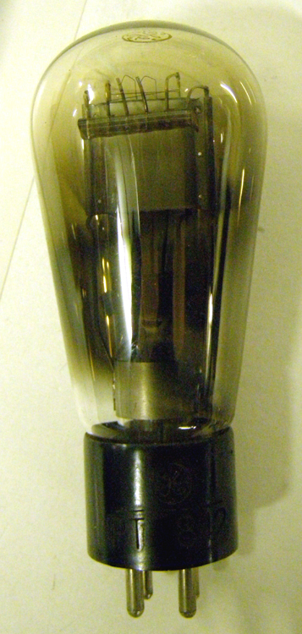
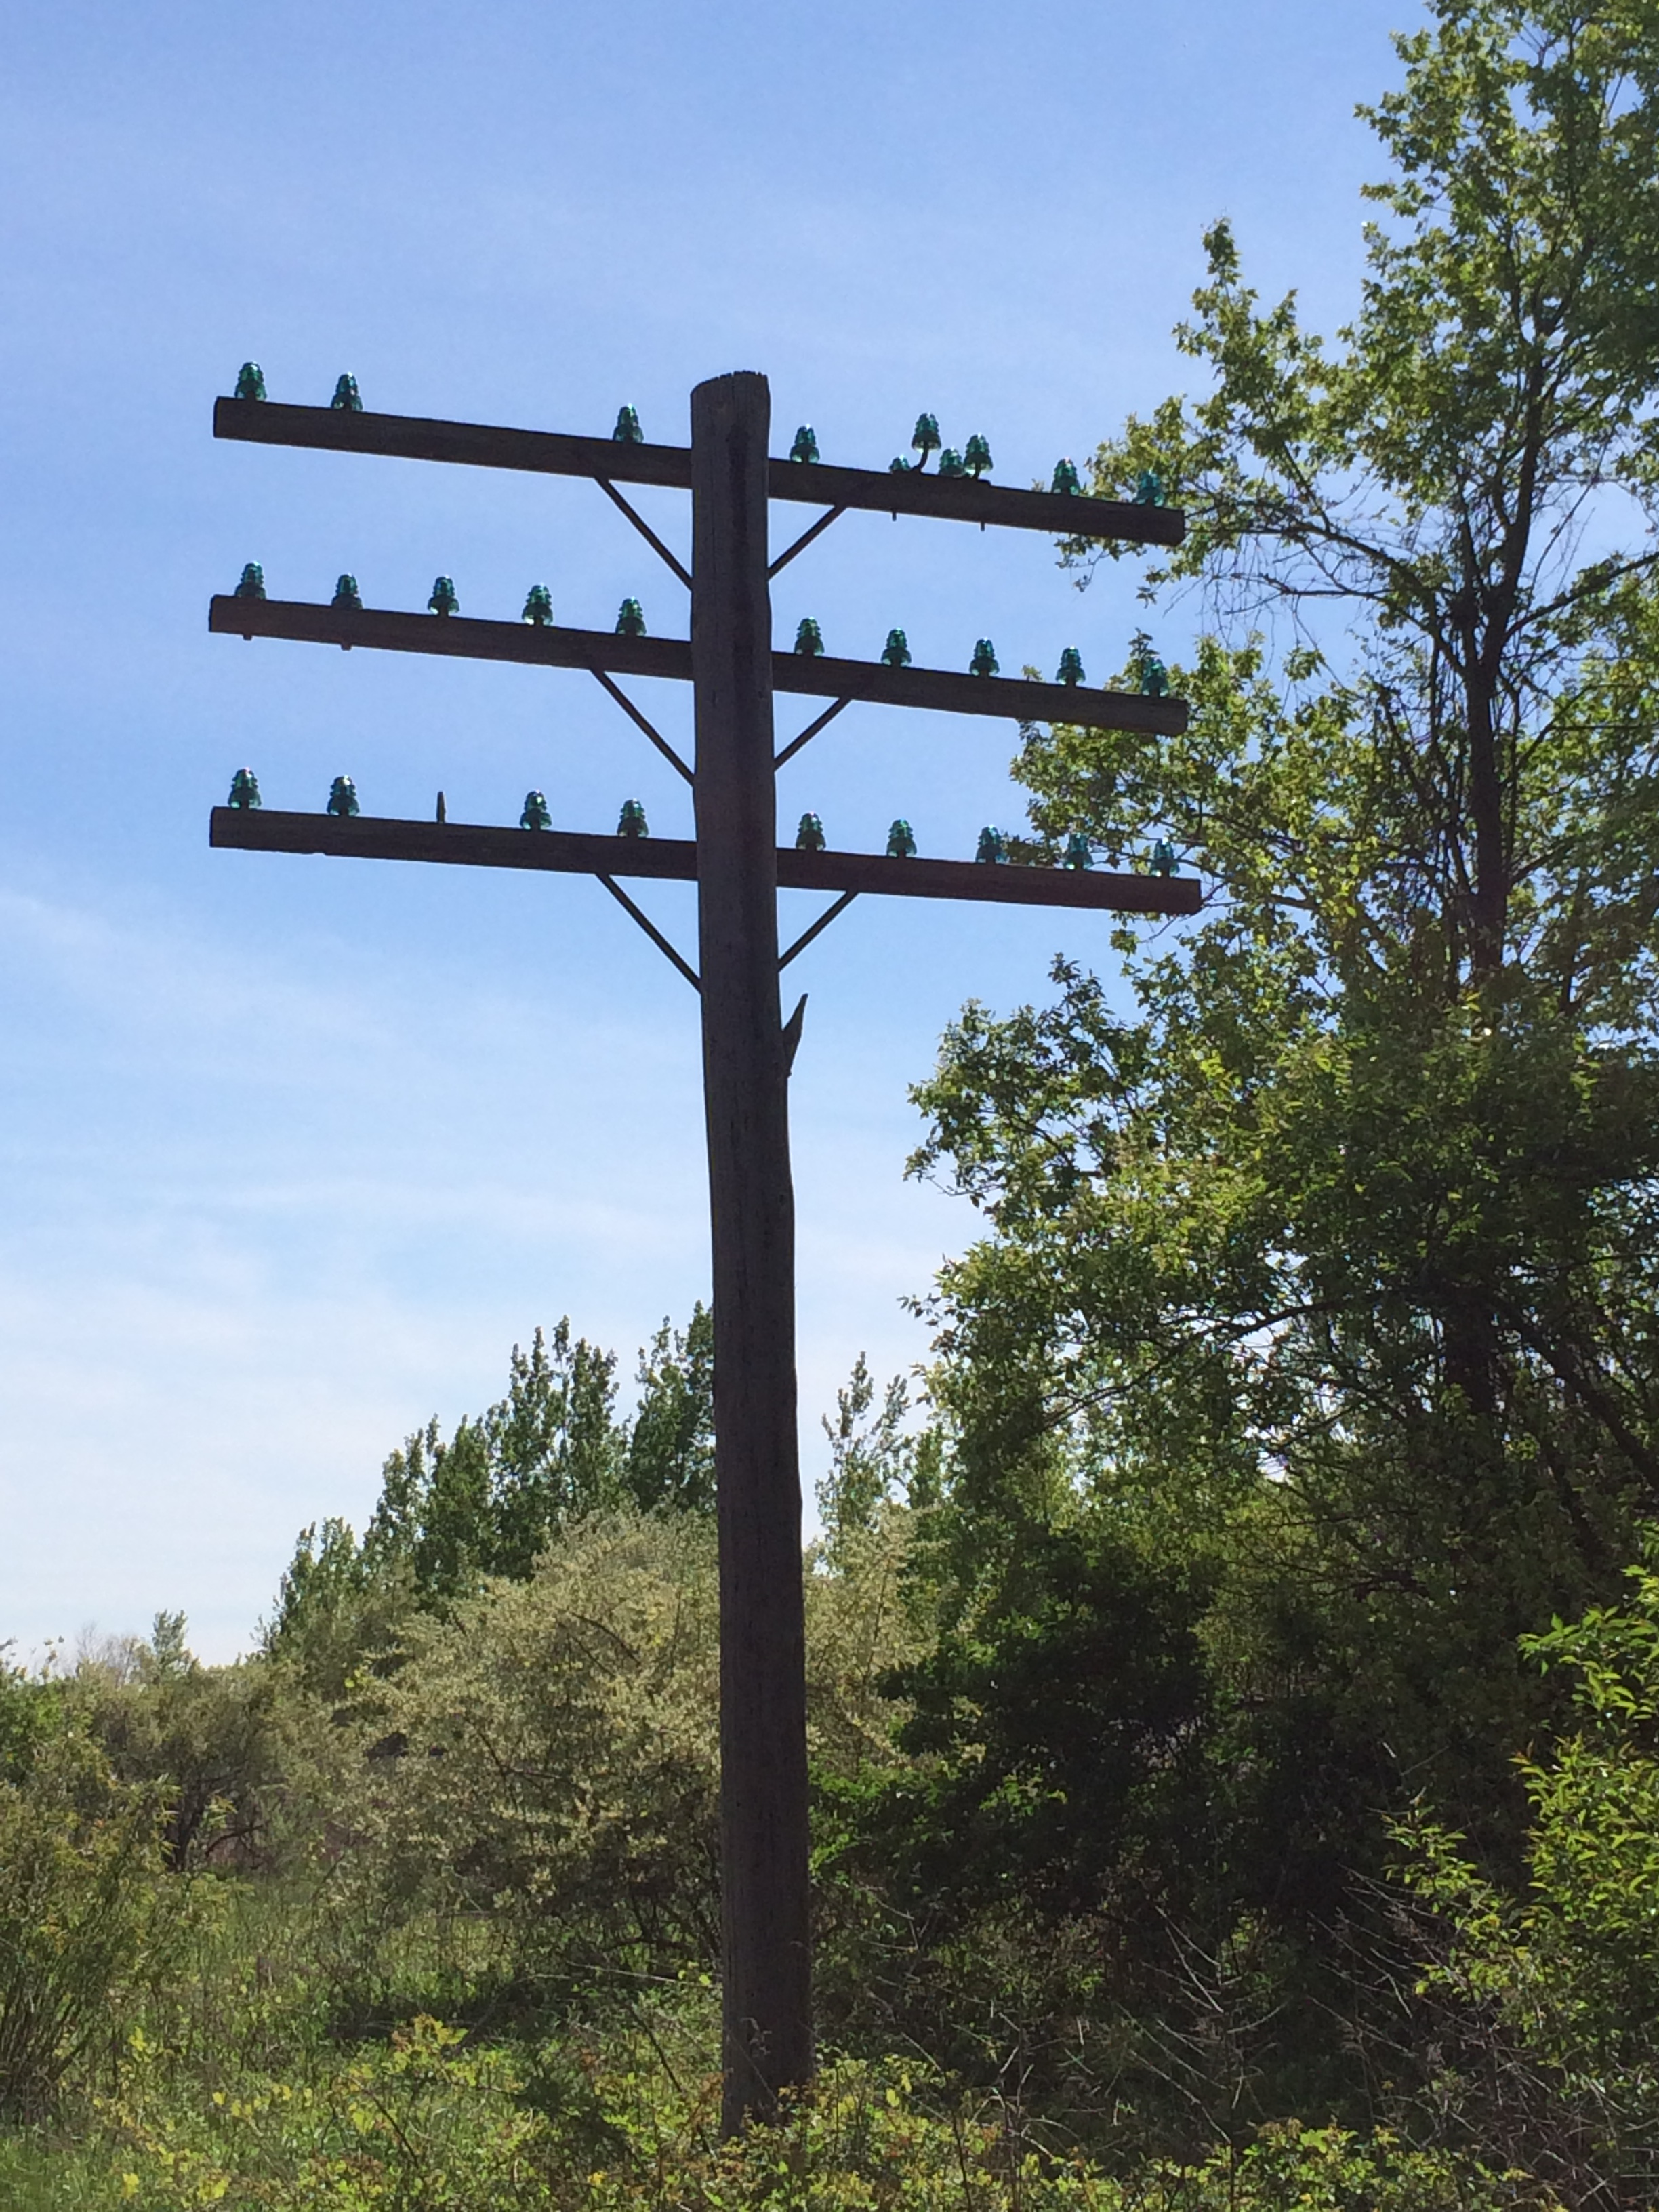
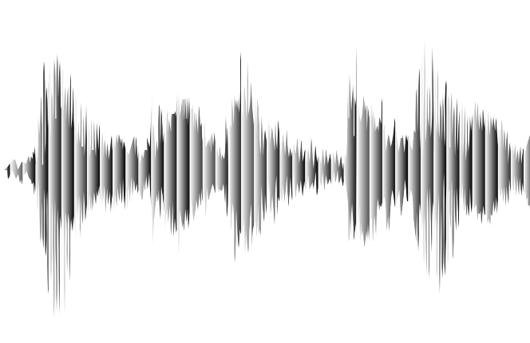
Valves / Tubes / Vacuum Tubes
The first purely electronic devices to store data and do computations were called "Valves" in the UK
About 1000 times faster than physical relays
Designed to amplify analog signals
Early application long distance analog telephone calls – needed an amplifier every 10 miles or so
Tube was invented in 1912 Dr. Lee Deforest
+
Output
Anode
Grid
Input
Cathode
⏚
https://en.wikipedia.org/wiki/Vacuum_tube

Slide 4
Building "Digital" Valves / Tubes
The design of tubes could be tweaked so to move quickly from low voltage to high voltage as the input voltage increased
Voltage low = off
Voltage high = on
With the correct design, a range of slightly lower input would be lifted on output
Transition
Digital
"Valve"
Audio
Amplifier
Output Voltage
Regenerate
Input Voltage
Notes:
The diagram on this page shows a graph of input voltage and output voltage comparing the response of an amplifier type tube to a tube that is designed more for digital applications (0/1). The amplifier graph starts low and then is a curve going up almost linearly over the range of the input voltage. The digital curve stays low longer and then goes up more vertically before tapering off at the top of the output voltage. The concept is that the transition from low to high if gradual and almost linear for the amplifier and quick and almost vertical for the tube tuned for digital applications. The digital tube goes "vertical" at about the 1/3 point of the input voltage – this means that the tub "pulls up" low non-zero voltages like 0.3 to 1 on output.

Slide 5
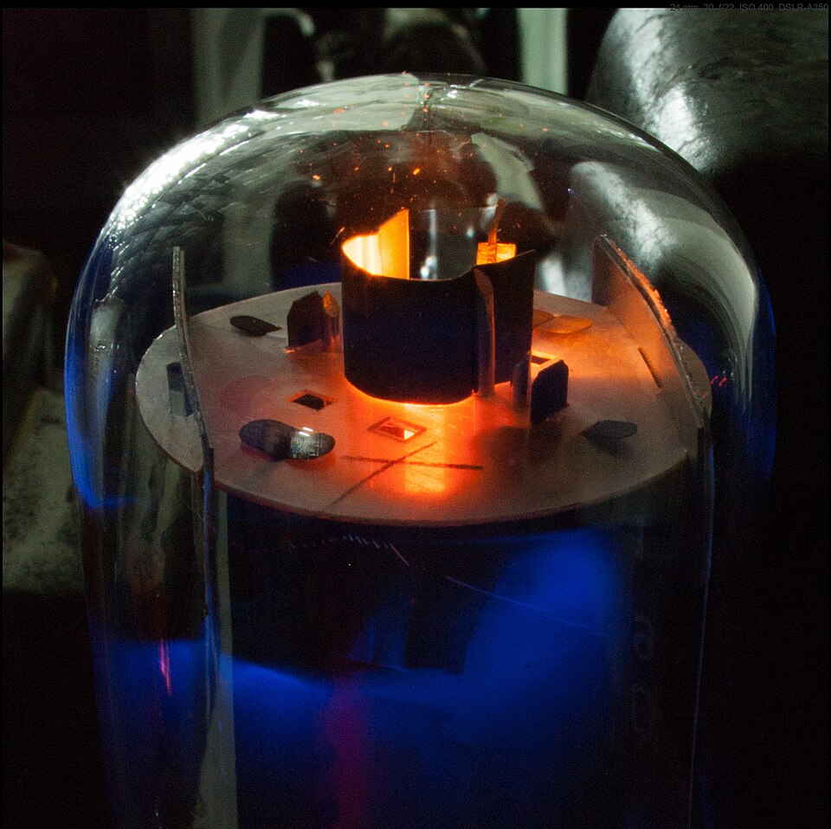
Flaws of Valves
Take lots of power per switch / bit
Lots of heat because each tube usually had a heater to make it easier to generate ions
Physically large
Expensive to manufacture
Made a soft humming noise
Soft electronic glow in the dark
https://en.wikipedia.org/wiki/Valve_amplifier

Slide 6
Semi-Conductors

Slide 7
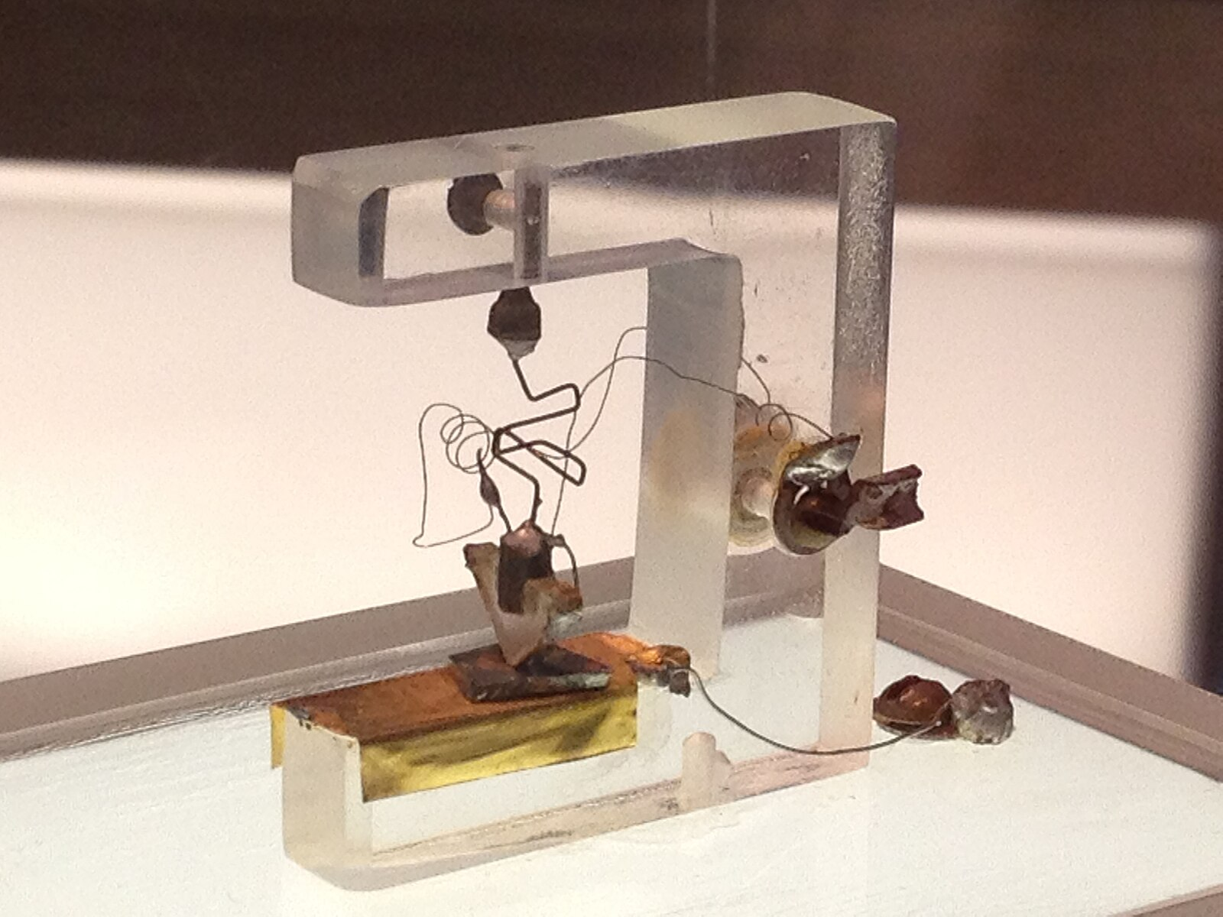
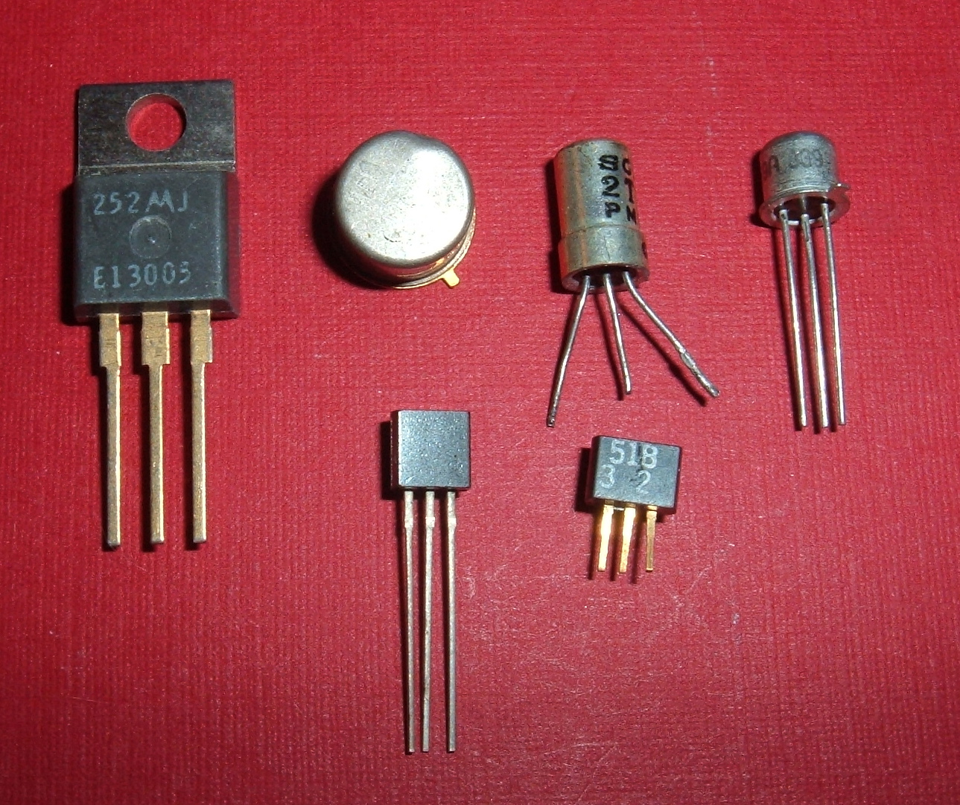
Transistors
Building a better Triode (Tube)
Three kinds of materials w.r.t electricity
Conducting like metal
Insulating like plastic
Certain crystals were "semi-conductors"
Semi conductors conduct electricity in certain situations
Lot of experimentation with crystal substances like silicon
https://en.wikipedia.org/wiki/Transistor
https://commons.wikimedia.org/wiki/File:1st-Transistor.jpg

Slide 8
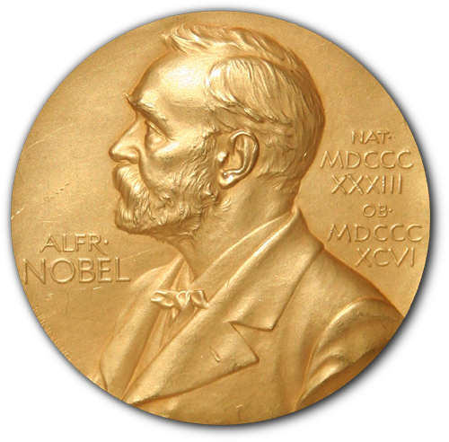

Nobel Prize!
+
Output
Anode
Transistors are constructed by layering crystals with carefully designed impurities
Silicon with N-Doping
Silicon with P-Doping
When voltages are applied to the crystals, sub-atomic stuff happens at the boundaries between the different types of crystals that affect the flow of electrons through the crystals
Grid
Input
Cathode
⏚
+
Output
Emitter
N
P
Base / Gate
Input
N
⏚
Collector
https://en.wikipedia.org/wiki/Nobel_Prize_in_Physics

Slide 9
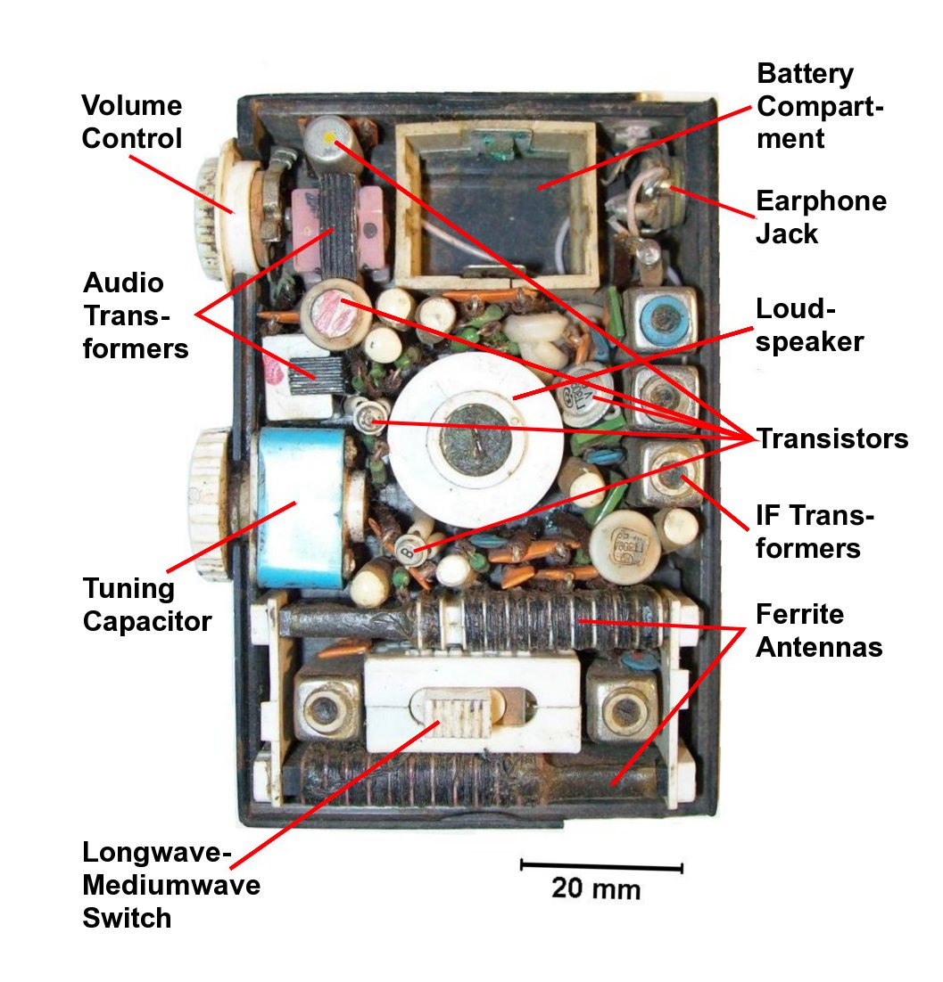
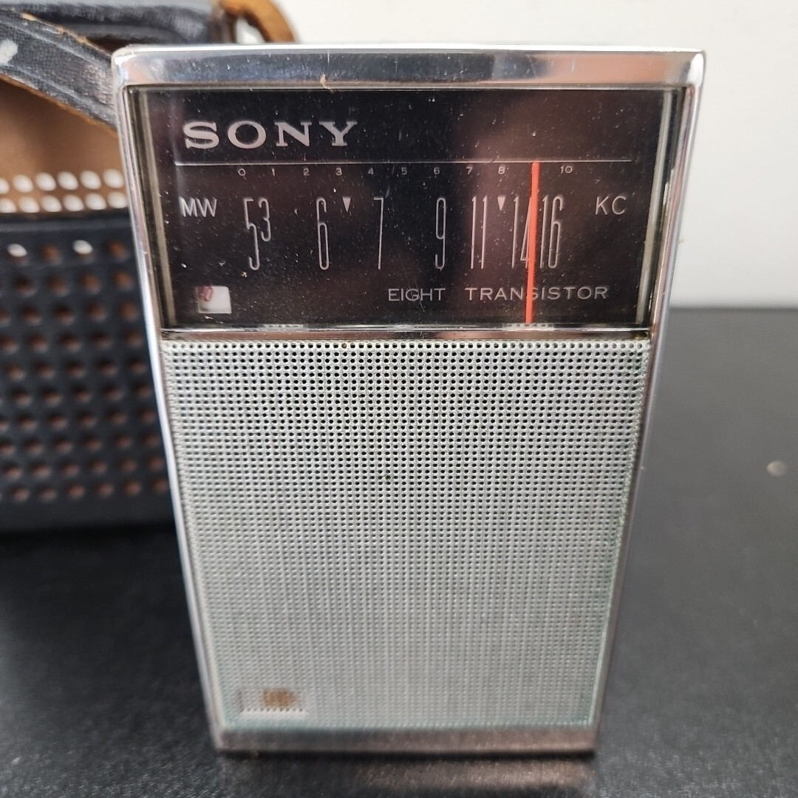
Transistor Radios
Once amplifier style transistors were available, during the 1940's there was an effort to build small, battery-powered "transistor radios"
Often the marketing included the number of transistors – "The Sony TR-826 radio has eight transistors!"
https://en.wikipedia.org/wiki/Transistor_radio

Slide 10
Building "Digital" Transistors
The design of transistors could be tweaked so to move quickly from low voltage to high voltage as the input voltage increased
Voltage low = off
Voltage high = on
With the correct design, a range of slightly lower input would be lifted on output
AI: Difference between a Bipolar Junction Transistor and NMOS transistor
Transition
Digital
"Valve"
Audio
Amplifier
Output Voltage
Regenerate
Input Voltage
Notes:
This is the transistor equivalent of the tube diagram a few slides back. The diagram on this page shows a graph of input voltage and output voltage comparing the response of an amplifier type transistor to a transistor that is designed more for digital applications (0/1). The amplifier graph starts low and then is a curve going up almost linearly over the range of the input voltage. The digital curve stays low longer and then goes up more vertically before tapering off at the top of the output voltage. The concept is that the transition from low to high if gradual and almost linear for the amplifier and quick and almost vertical for the transistor tuned for digital applications. The digital tube goes "vertical" at about the 1/3 point of the input voltage – this means that the transistor "pulls up" low non-zero voltages like 0.3 to 1 on output.

Slide 11
Two Kinds of "Digital" Transistors
If you take a normal amplifier transistor and tune it to be "more on / off" you get an NMOS transistor
Open until a voltage is applied
Dominated in early chips
With a bit more work you can make a PMOS transistor
Closed until a voltage is applied
Modern chips use CMOS (NMOS and PMOS working together)
Transition
NMOS
Output Voltage
Input Voltage
PMOS
https://en.wikipedia.org/wiki/MOSFET
Notes:
PMOS (p-channel metal-oxide-semiconductor) refers to a type of field-effect transistor (FET) where the current flow is carried by positively charged "holes"
NMOS (n-type metal–oxide–semiconductor) refers to a type of field-effect transistor (FET) where the channel between the source and drain is made of n-type semiconductor material
The graph on this slide shows an NMOS S-curve going from low to high output voltage with an almost vertical transition at the 1/3 point in the input voltage. The 1/3 point helps pull up voltages that might not quiet be 1 on input to 1 on output. The PMOS S-Curve goes from high to low with an almost vertical drop at about the 2/3 point in the input voltage. The 2/3 point helps pull down voltages that might no quite be 0 on input to be 0 on output.

Slide 12
Digital Logic and Gates

Slide 13
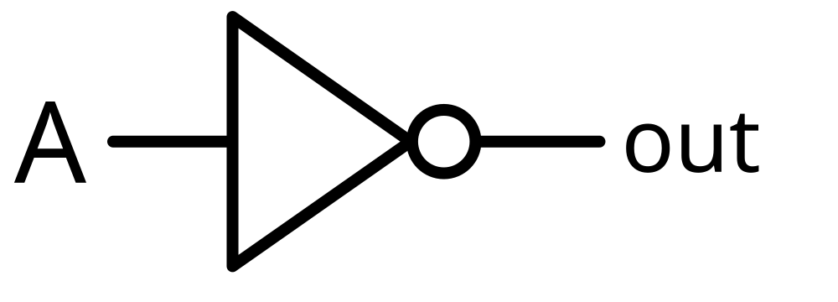
We use transistors to implement "gates"
When we build digital logic we think in terms of abstractions that we call "gates"
Gates let us think about in 1's and 0's instead of voltages
The simplest gate is a "not" gate where the output is the opposite of the input
It demonstrates a circuit that reacts – like a simple "if" statement
We will build more complex logic circuits
Input | Output
0 | 1
1 | 0
https://en.wikipedia.org/wiki/Inverter_(logic_gate)

Slide 14
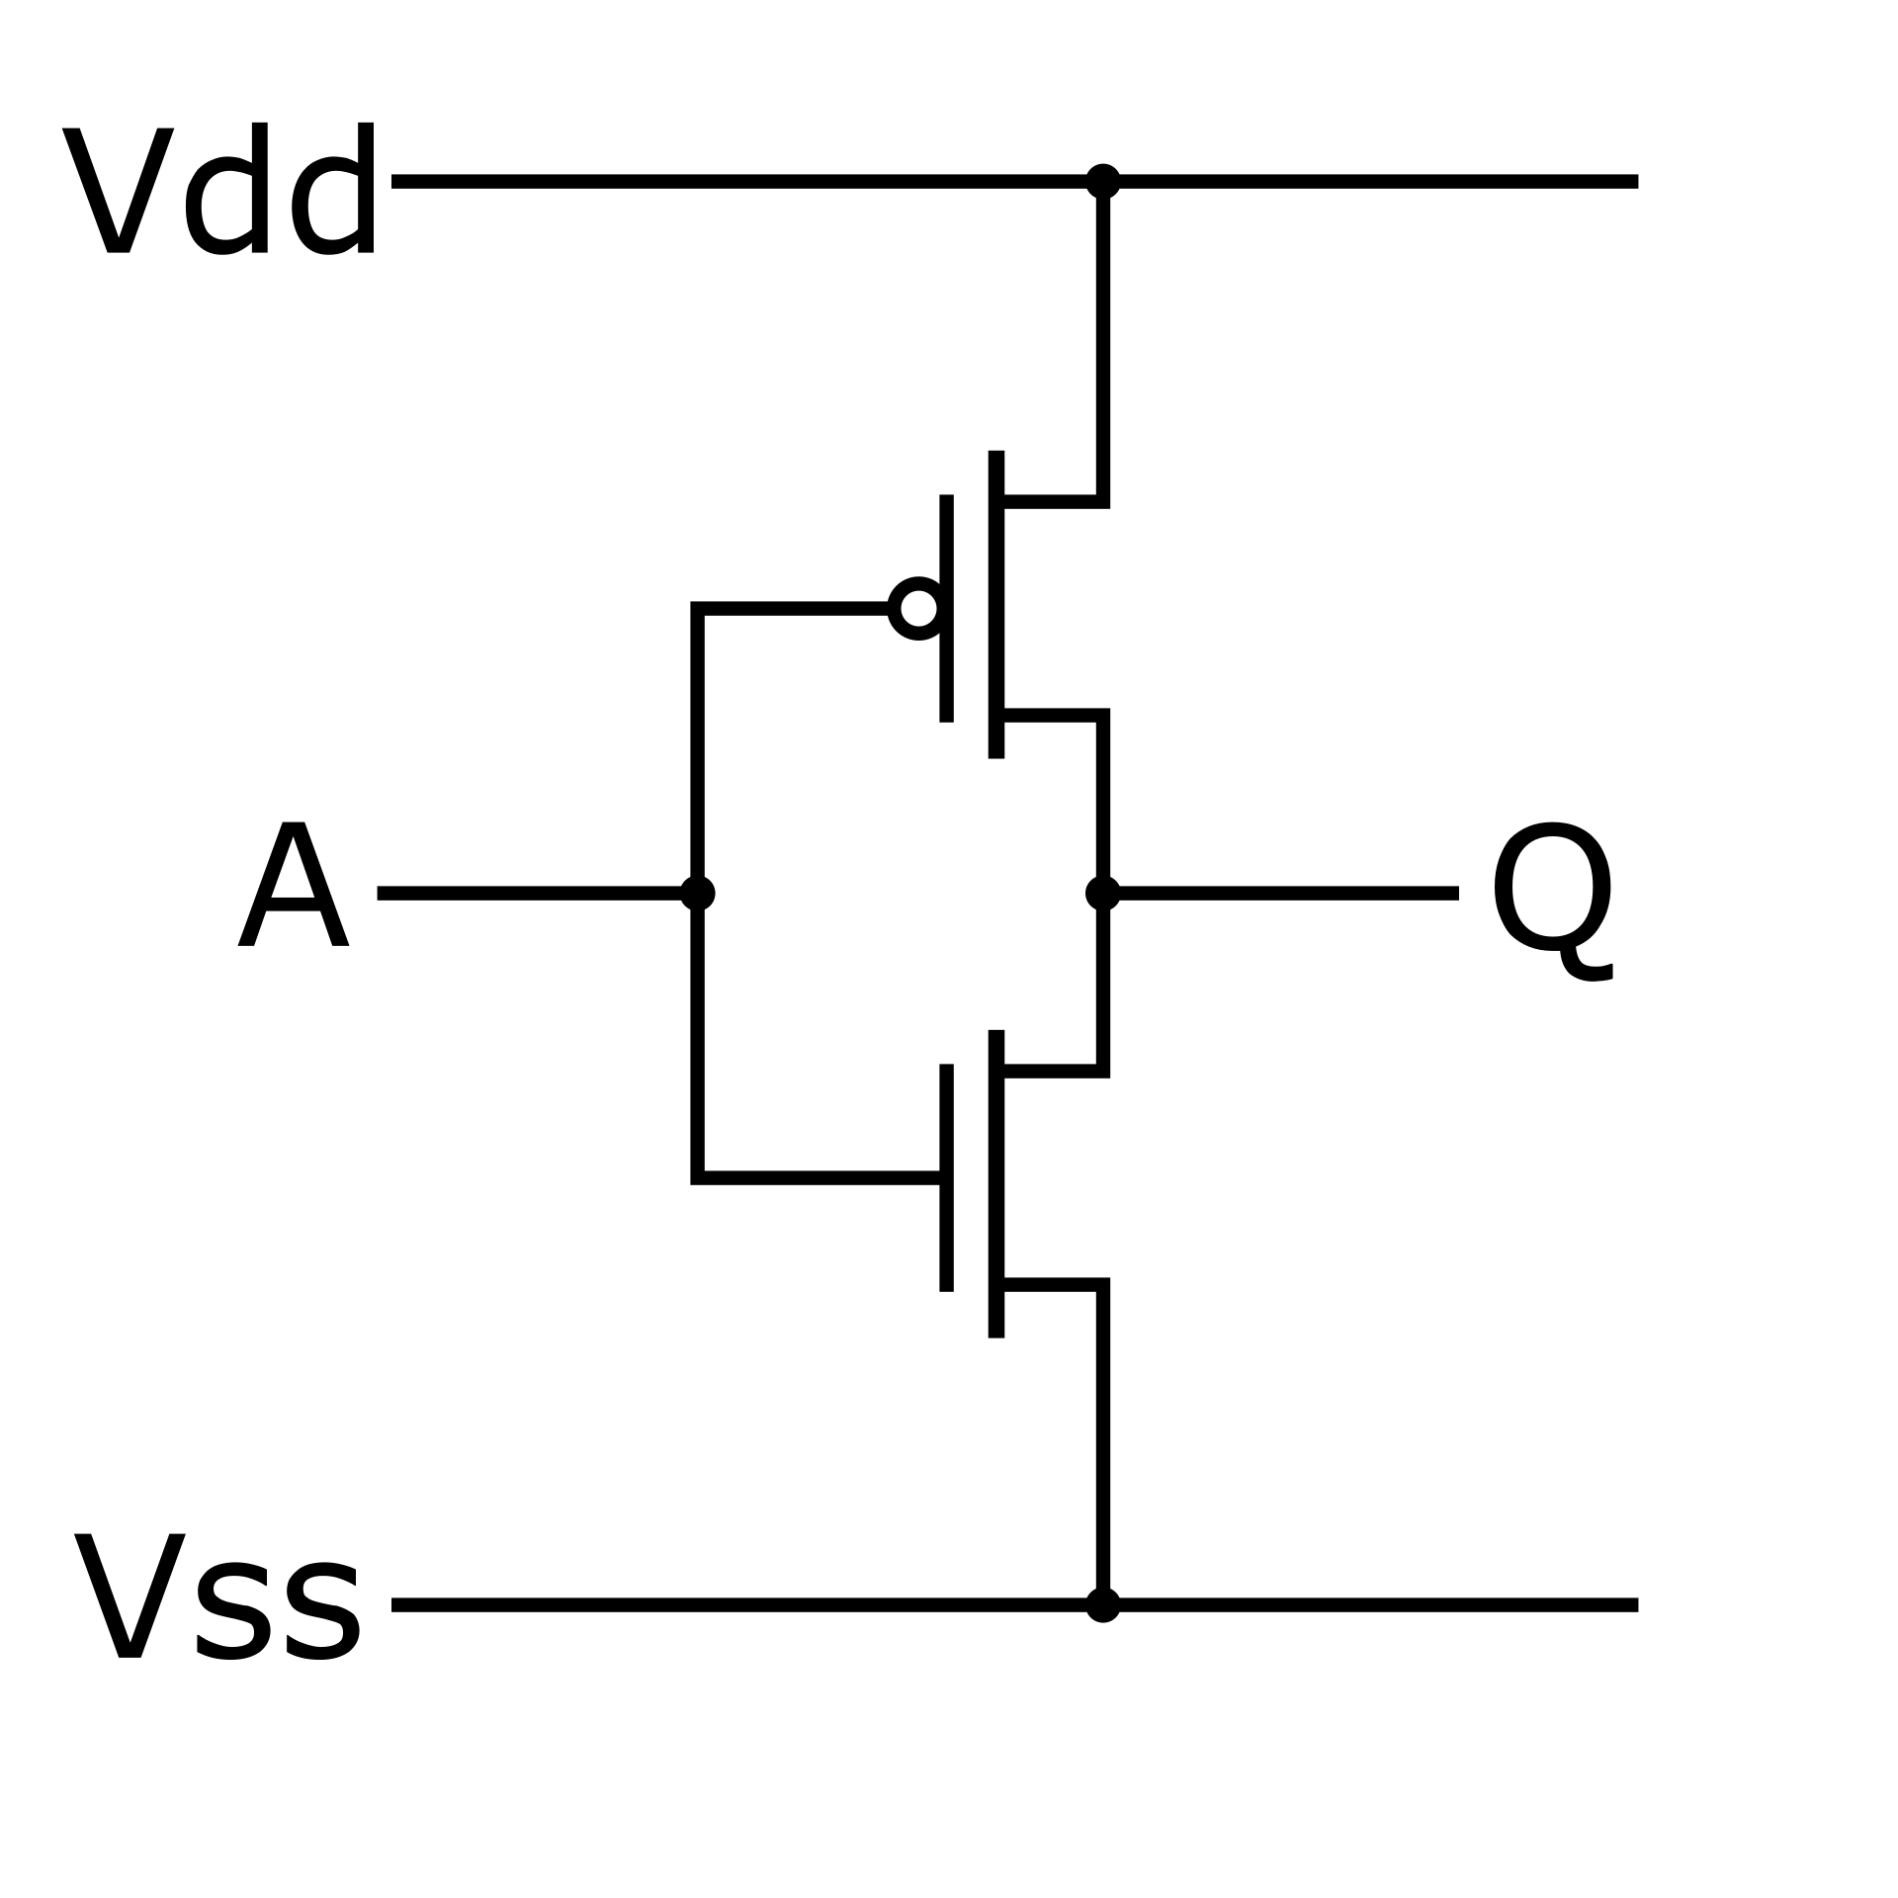
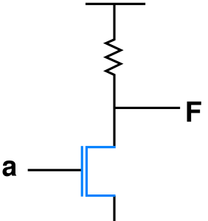
Not gates over time..
NMOS transistors were available much earlier than PMOS
Power hungry
Lots of heat
NMOS + PMOS
Reduced power
Reduced heat
Power and heat greatly affect chip density
Vdd
Vdd
out
A
out
A
⏚
⏚
Early - NMOS
Modern - CMOS

Slide 15
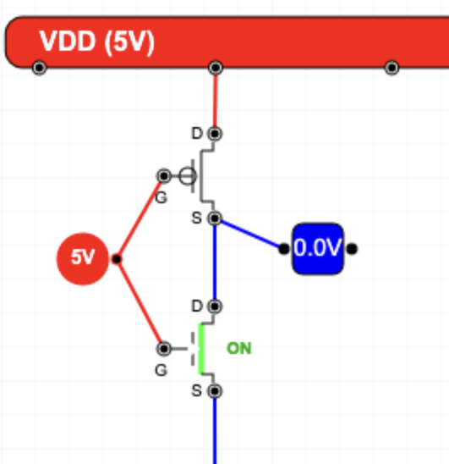
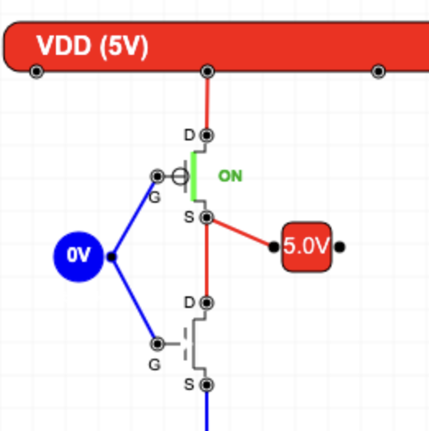
Layout a CMOS NOT Gate (Demo)
https://www.ca4e.com/tools/cmos/

Slide 16
Digital Logic
To design more complex circuits from half-adders to CPUs it is much easier to think in terms of gates than transistors
Gates are an abstraction
On / OFF or 1 / 0
The basic gates come from mathematical logic (and IF statements)
Not / And / Or / Exclusive Or
We also talk about gates that can be built with fewer transistors
NAND / NOR

Slide 17
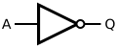
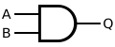
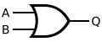
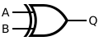
Classic Mathematical Logic Gates
Not
And
Or
Exclusive Or
A | B | Q
0 | 0 | 0
0 | 1 | 0
1 | 0 | 0
1 | 1 | 1
A | B | Q
0 | 0 | 0
0 | 1 | 1
1 | 0 | 1
1 | 1 | 1
A | B | Q
0 | 0 | 0
0 | 1 | 1
1 | 0 | 0
1 | 1 | 1
A | Q
0 | 1
1 | 0
Two transistors
Six transistors
Six transistors
Eight transistors

Slide 18
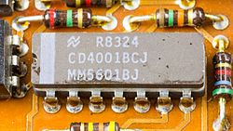
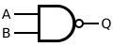
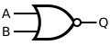
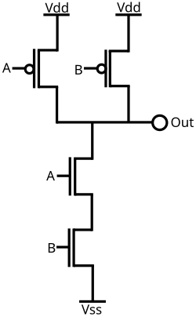
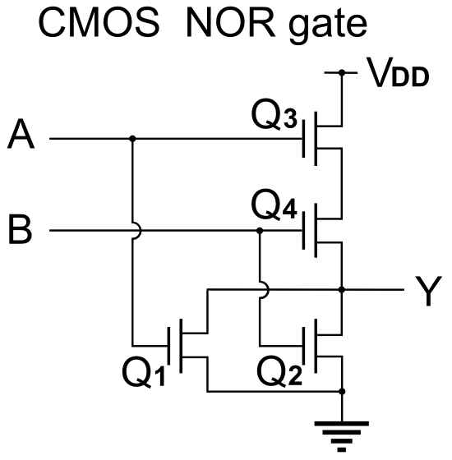
NAND and NOR Fewer transistors
NAND
NOR
A | B | Q
0 | 0 | 1
0 | 1 | 1
1 | 0 | 1
1 | 1 | 0
A | B | Q
0 | 0 | 1
0 | 1 | 0
1 | 0 | 0
1 | 1 | 0
Four transistors
Four transistors
Images: Wikipedia

Slide 19
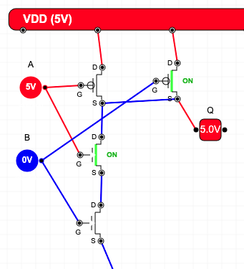
Layout a CMOS NAND Gate
A | B | Q
0 | 0 | 1
0 | 1 | 1
1 | 0 | 1
1 | 1 | 0

Slide 20
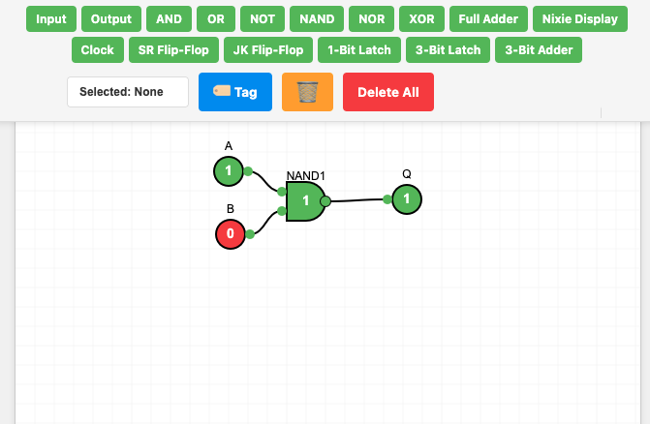
Sneak Peek: Digital Logic Design

Slide 21
Increasing Transistor Count

Slide 22
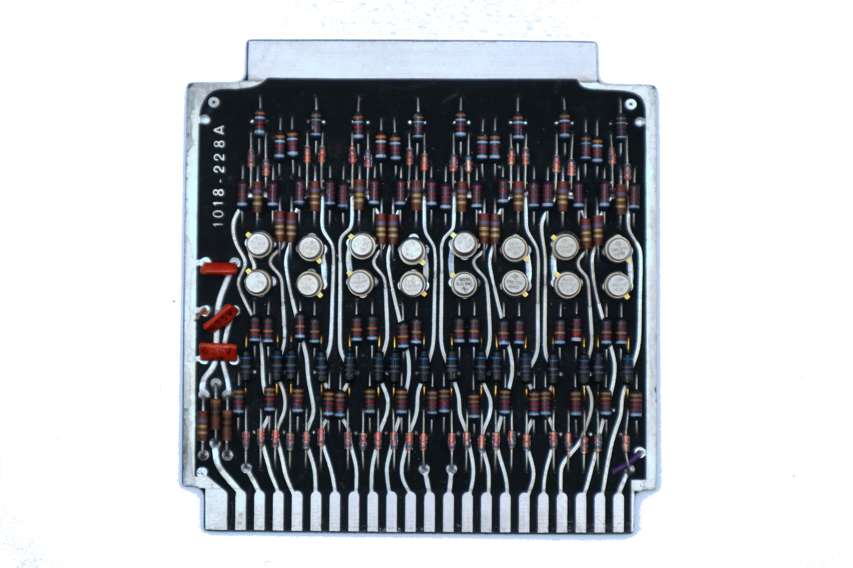
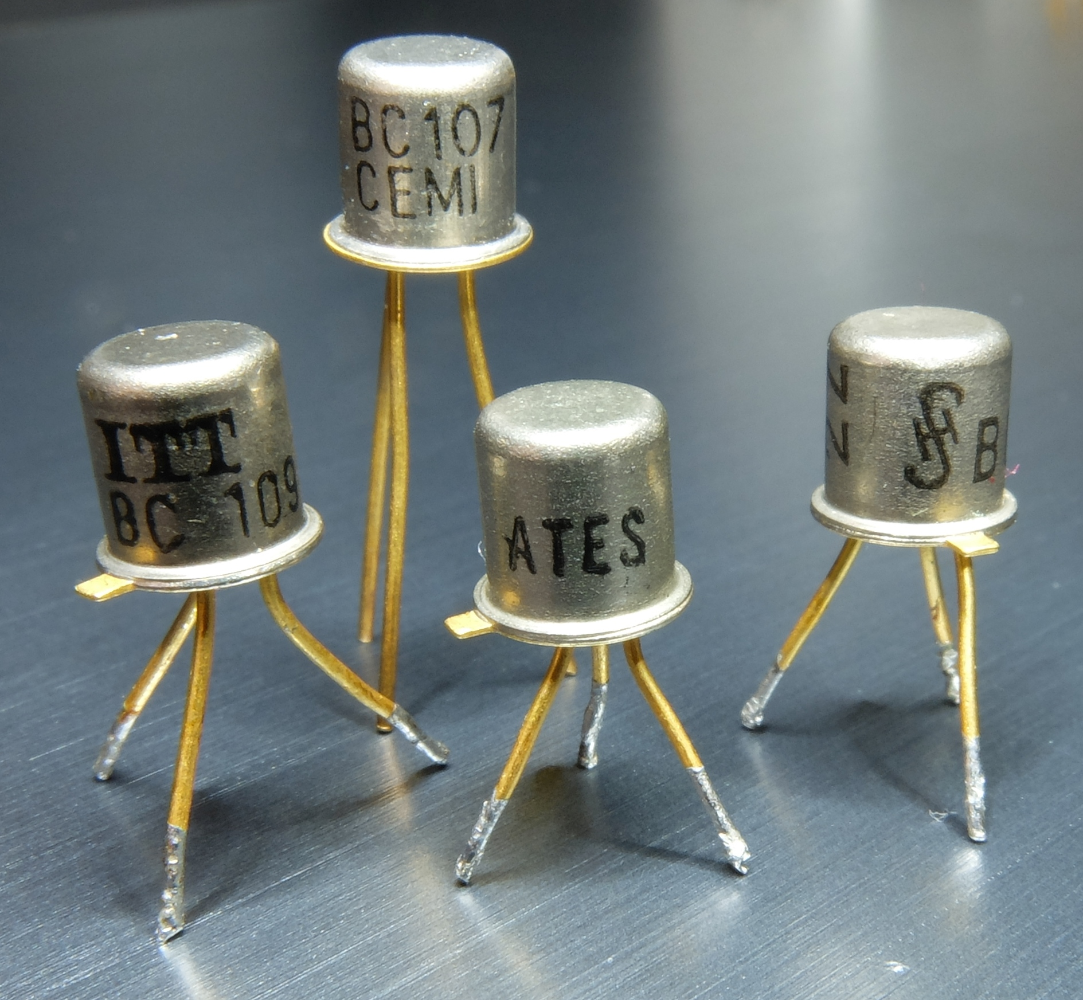
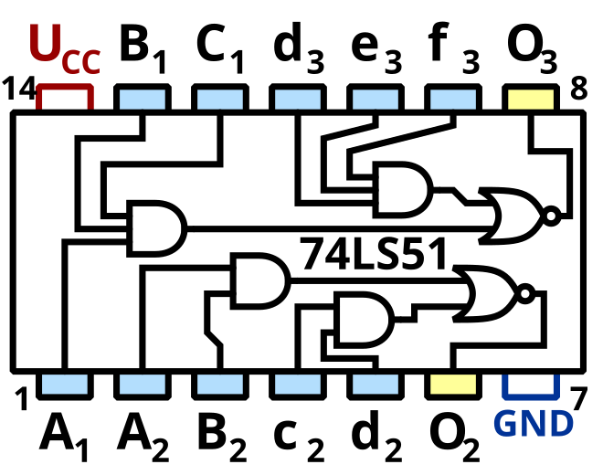
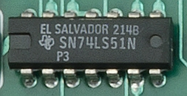
Scale Over Time
Individual transistors connected with other electronics on a "board"
Integrated circuits with a few transistors or gates
https://en.wikipedia.org/wiki/TO-18
https://en.wikipedia.org/wiki/List_of_7400-series_integrated_circuits

Slide 23

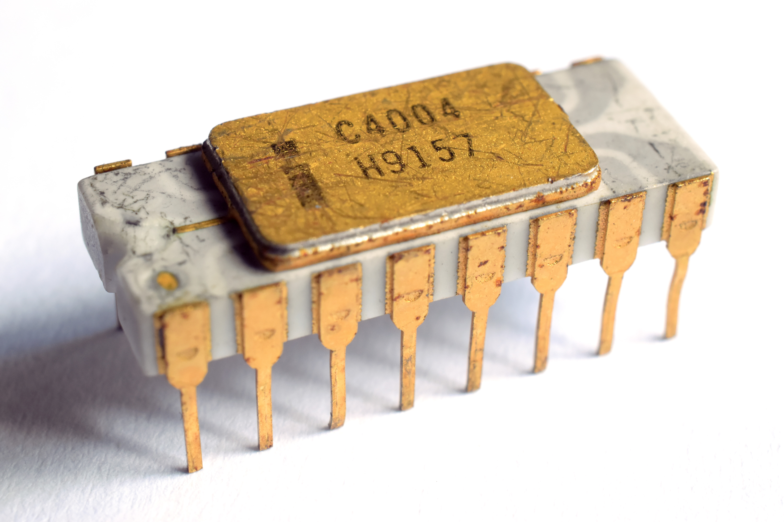
Very Large Scale Integration (VLSI)
2300 transistors manufactured using photo lithography
The Intel 4004(1971), was first microprocessor you could buy
3mm
4mm
https://en.wikipedia.org/wiki/Intel_4004

Slide 24
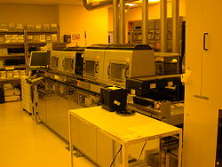
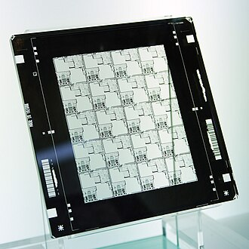
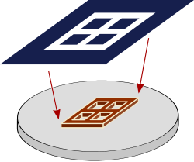
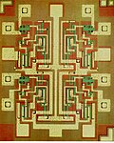
Photo Lithography
Multiple masks with
different chemicals
Four Input NAND
Seven transistors
TI 7420
https://en.wikipedia.org/wiki/Photolithography
https://en.wikipedia.org/wiki/Photomask
https://en.wikipedia.org/wiki/Semiconductor_device_fabrication

Slide 25
Growth of transistor count
The Intel Itanium was the first billion-transistor chip in 2001
Deep learning wafer scale engine by Cerebras has 2.6 trillion MOSFETs 2020
2 Terabyte flash memory with 5.3 trillion floating-gate MOSFETs
Nvidia's Blackwell-based B100 GPU with 208 billion MOSFETs in 2024
https://en.wikipedia.org/wiki/Transistor_count

Slide 26
Very Large Scale Integration (VLSI) Layout

Slide 27
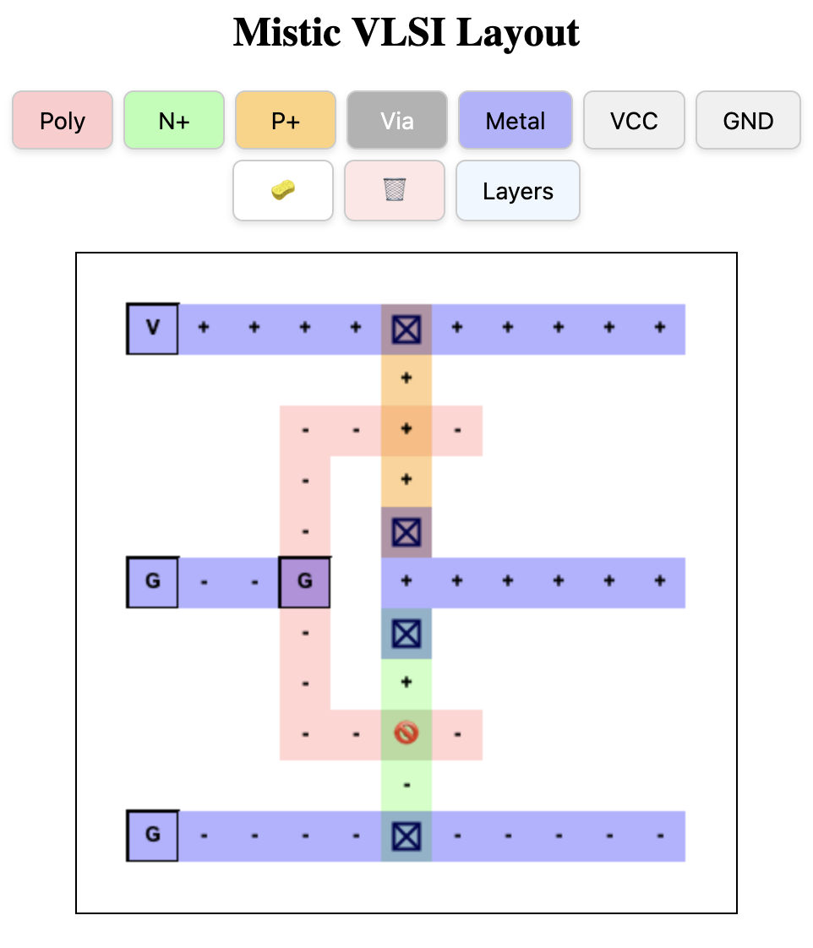
VLSI CMOS Not
Vdd
Not
A
out
A | Q
0 | 1
1 | 0
⏚

Slide 28
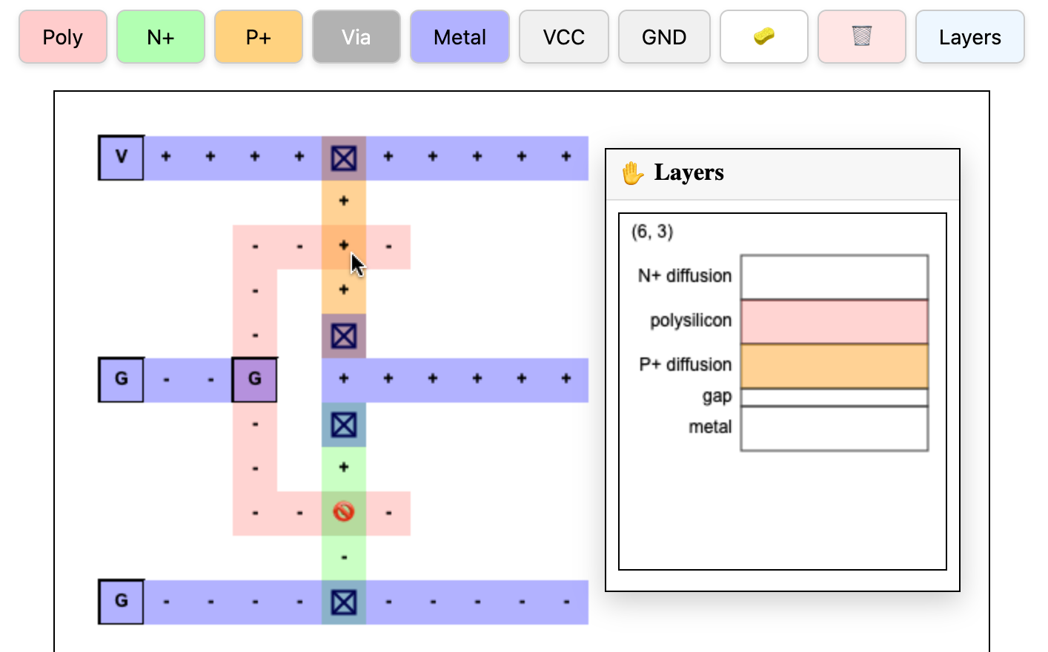
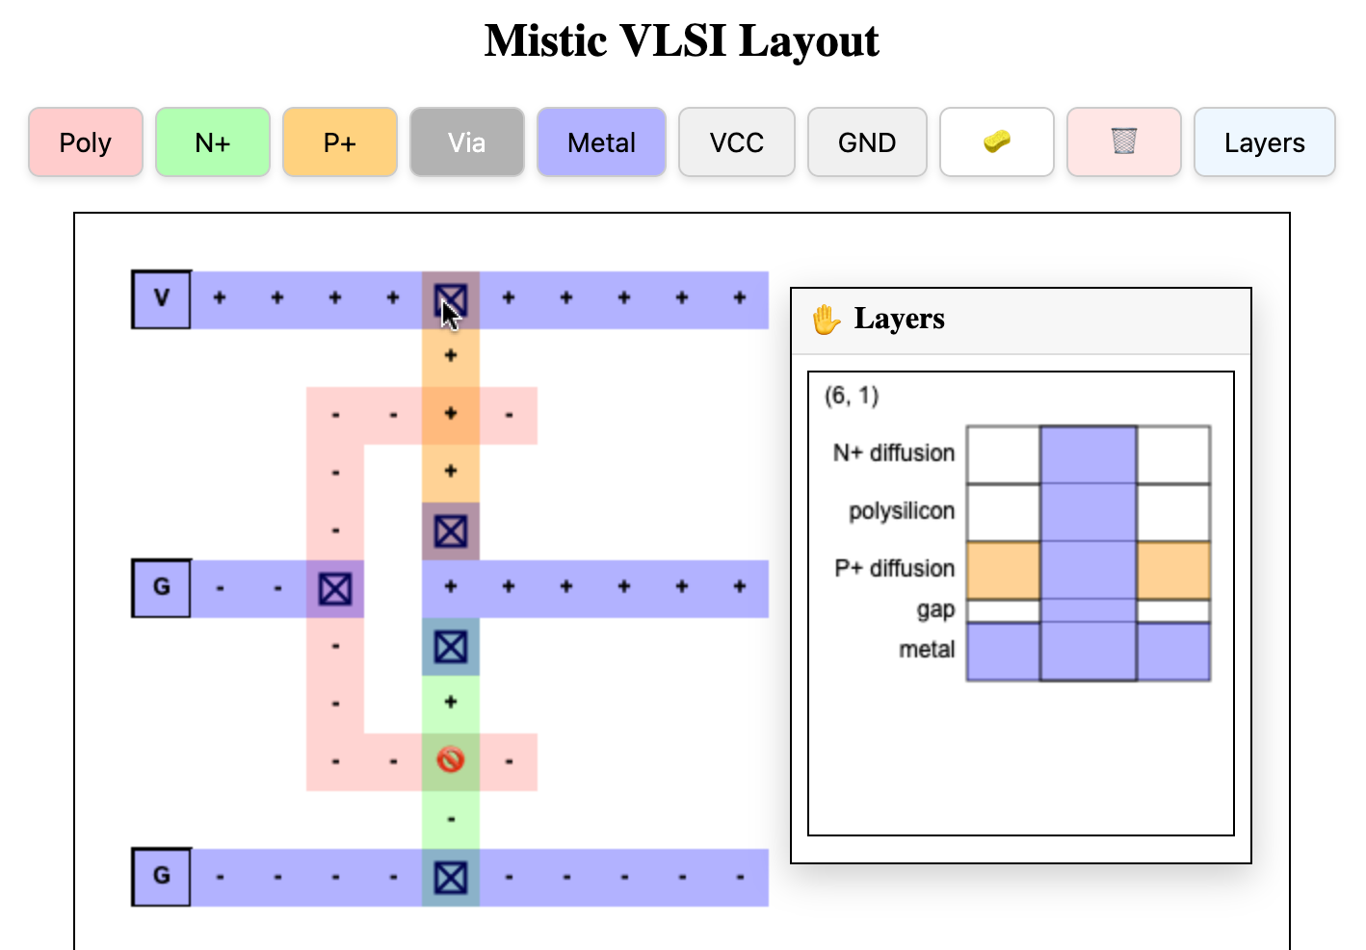
VLSI Layers – Photo Lithography

Slide 29
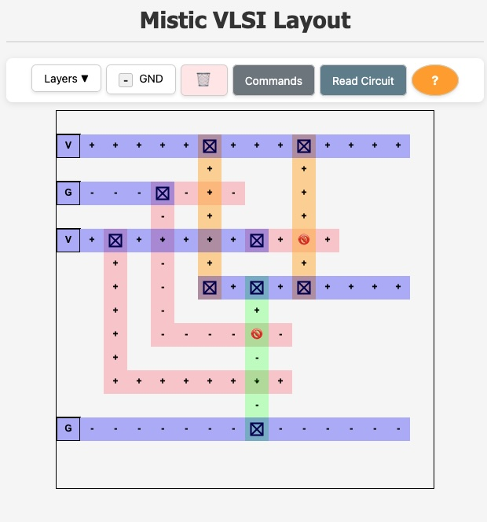
VLSI CMOS NAND
A | B | Q
0 | 0 | 1
0 | 1 | 1
1 | 0 | 1
1 | 1 | 0

Slide 30
VLSI CMOS NAND
A | B | Q
0 | 0 | 1
0 | 1 | 1
1 | 0 | 1
1 | 1 | 0

Slide 31
Summary
Semiconductors
Tuning tubes and transistor for digital applications (as compared to amplifier applications)
Building gates from transistors
Implementations using NMOS and CMOS logic (heat and power)
Number of transistors on a chip over time
Photo lithography
Designing VLSI chips

Slide 32
Acknowledgements / Contributions
These slides are Copyright 2025- Charles R. Severance (online.dr-chuck.com) as part of www.ca4e.com and made available under a Creative Commons Attribution 4.0 License. Please maintain this last slide in all copies of the document to comply with the attribution requirements of the license. If you make a change, feel free to add your name and organization to the list of contributors on this page as you republish the materials.
Initial Development: Charles Severance, University of Michigan School of Information
Insert new Contributors and Translators here including names and dates
Continue new Contributors and Translators here

